Slide 1
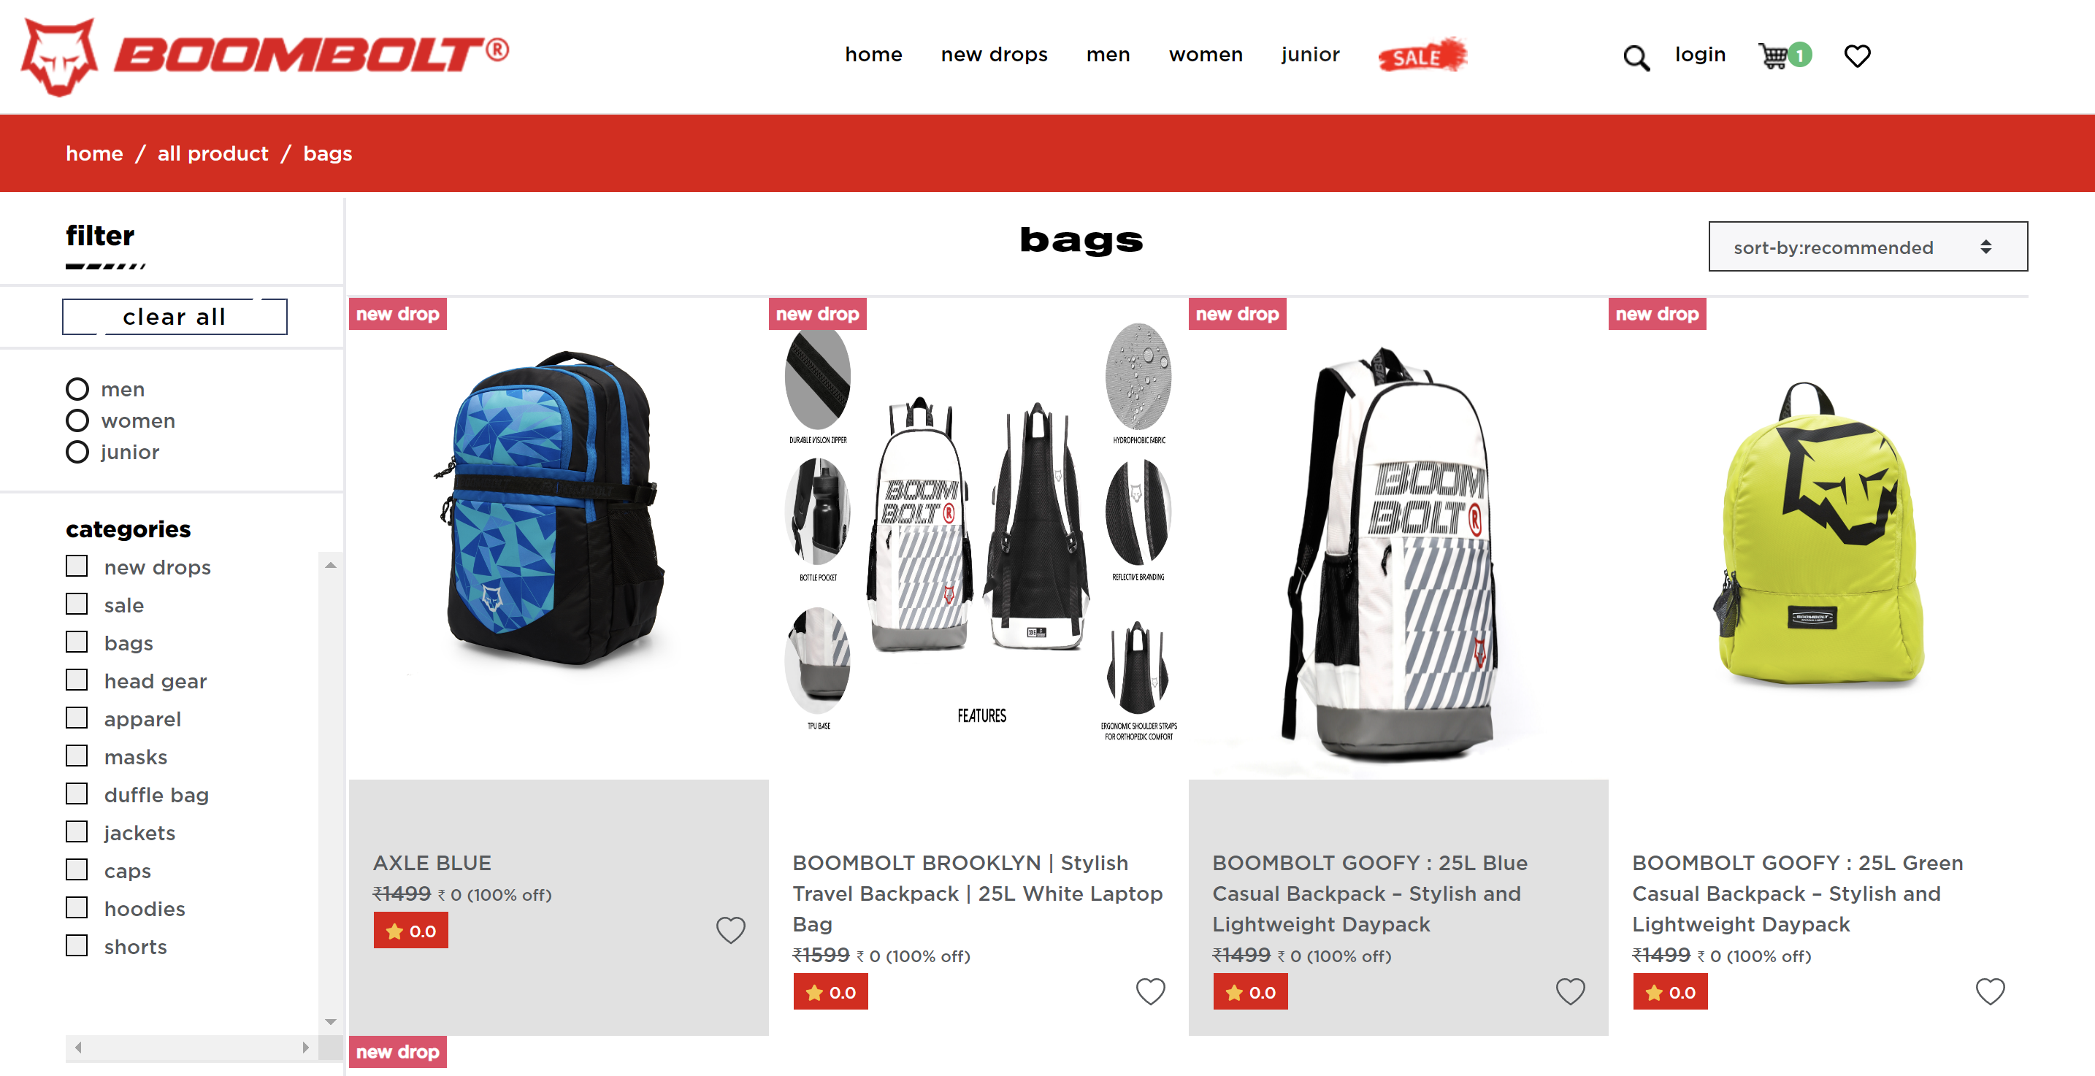
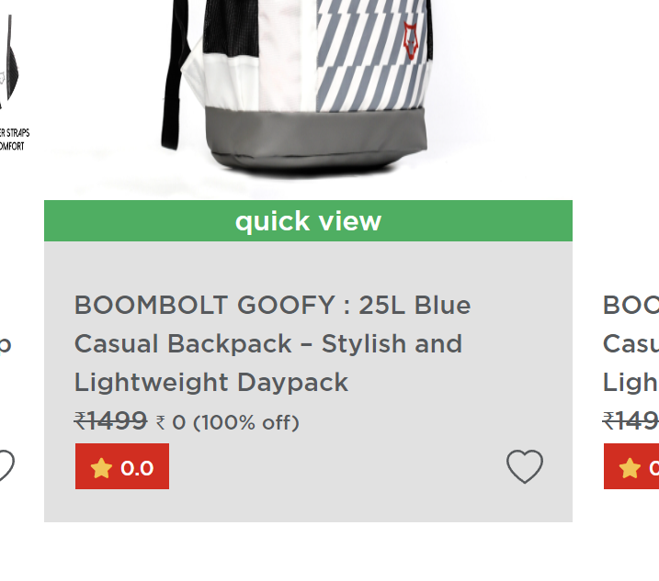
1. All the Images are out of proportion 2. Grey box has so much free

Slide 2
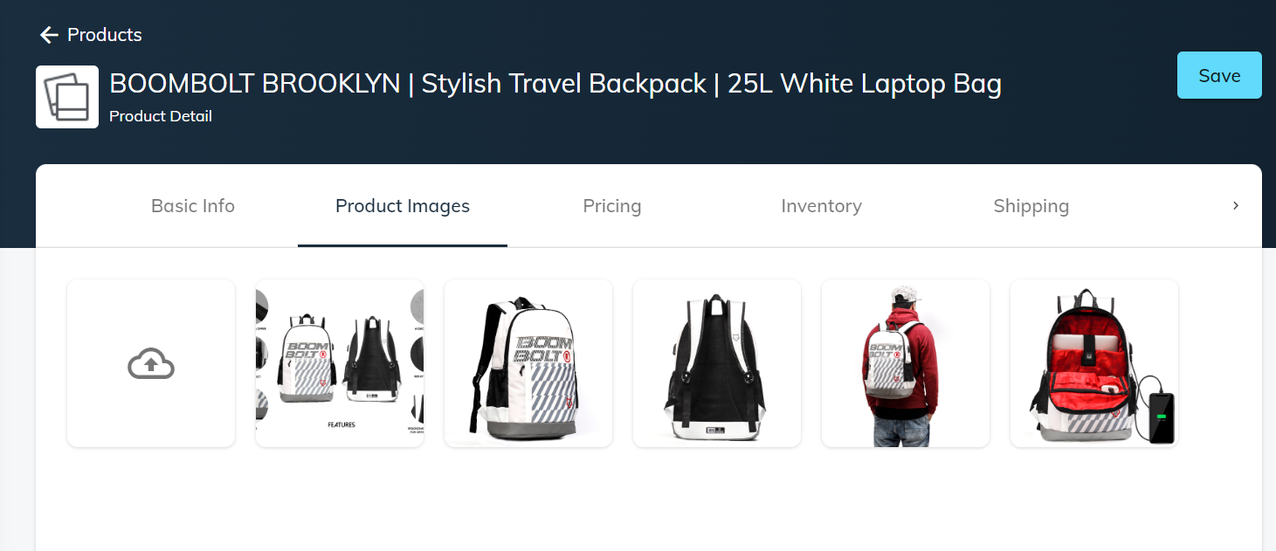
1. In admin panel all images are properly visible.

Slide 3
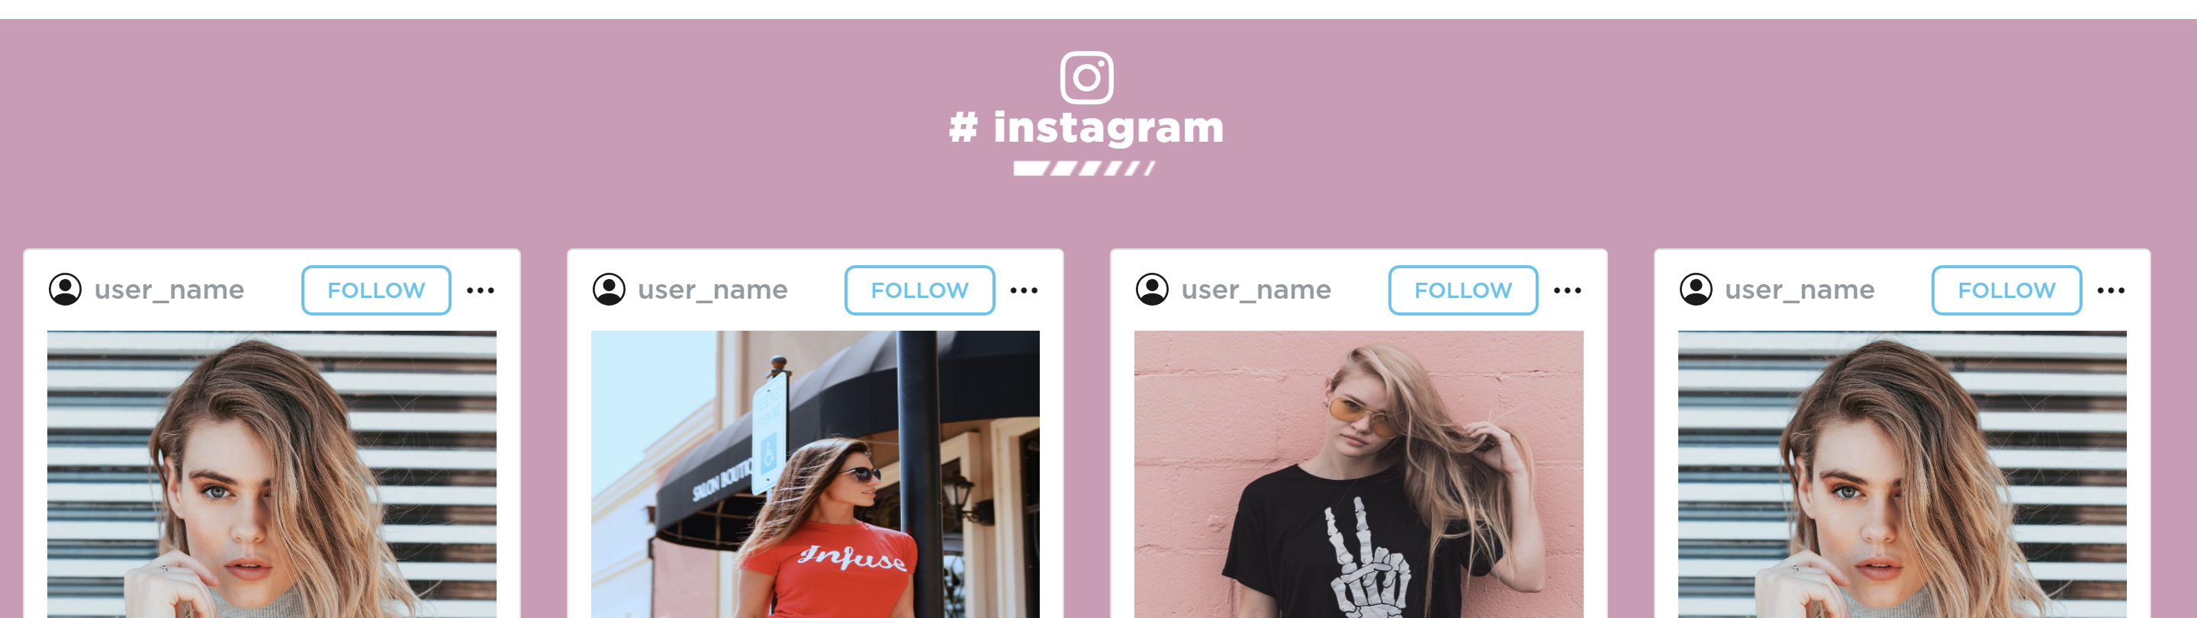
Space between intagram logo and white boxes is too much.

Slide 4
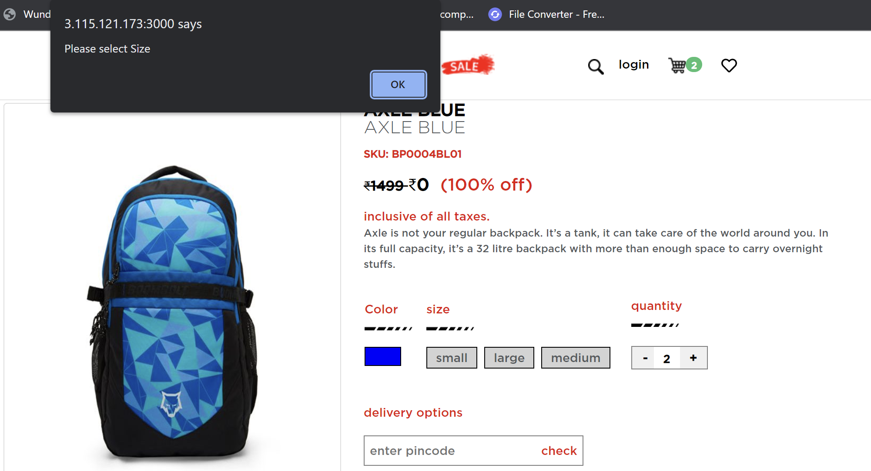
For Backpacks, Size is not to be shown. Still Pop Up shows to select size
Adding quantity is not reflecting the price change.

Slide 5
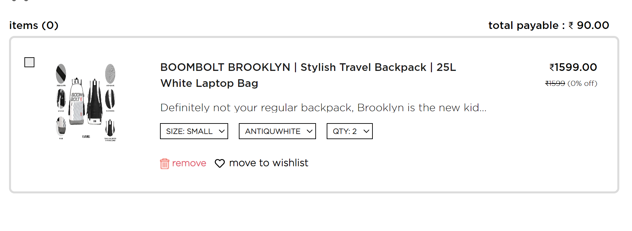
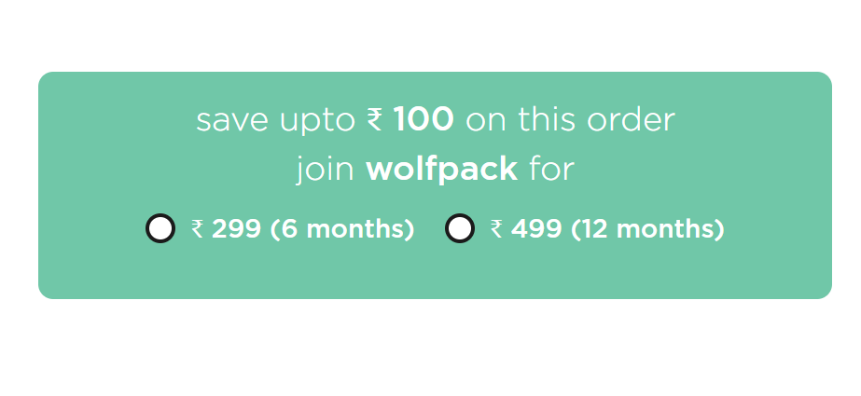
Adding quantity is not reflecting the price change in the check out page.
Move to wishlist not working
Wolfpack selection not working. The page just goes blank.

Slide 6
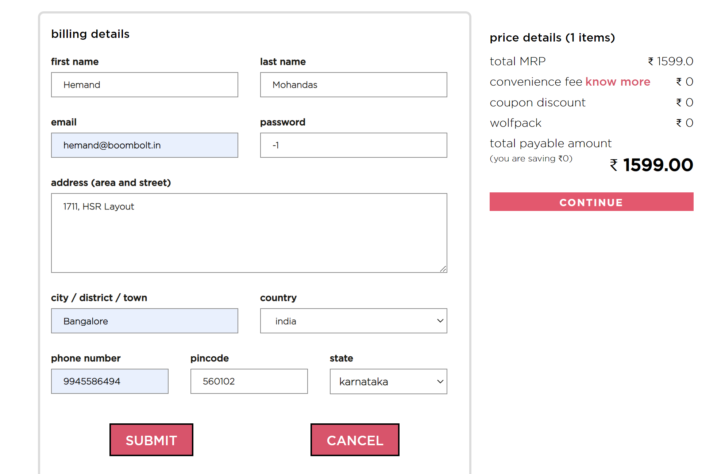
Password has drop down arrows and shows -1 etc. Not working with alphabets. Phone number and pin codes also shows drop down arrows.
Country and State Drop downs has all names in Small case.
SUBMIT AND CANCEL Boxes are too large for the page.

Slide 7
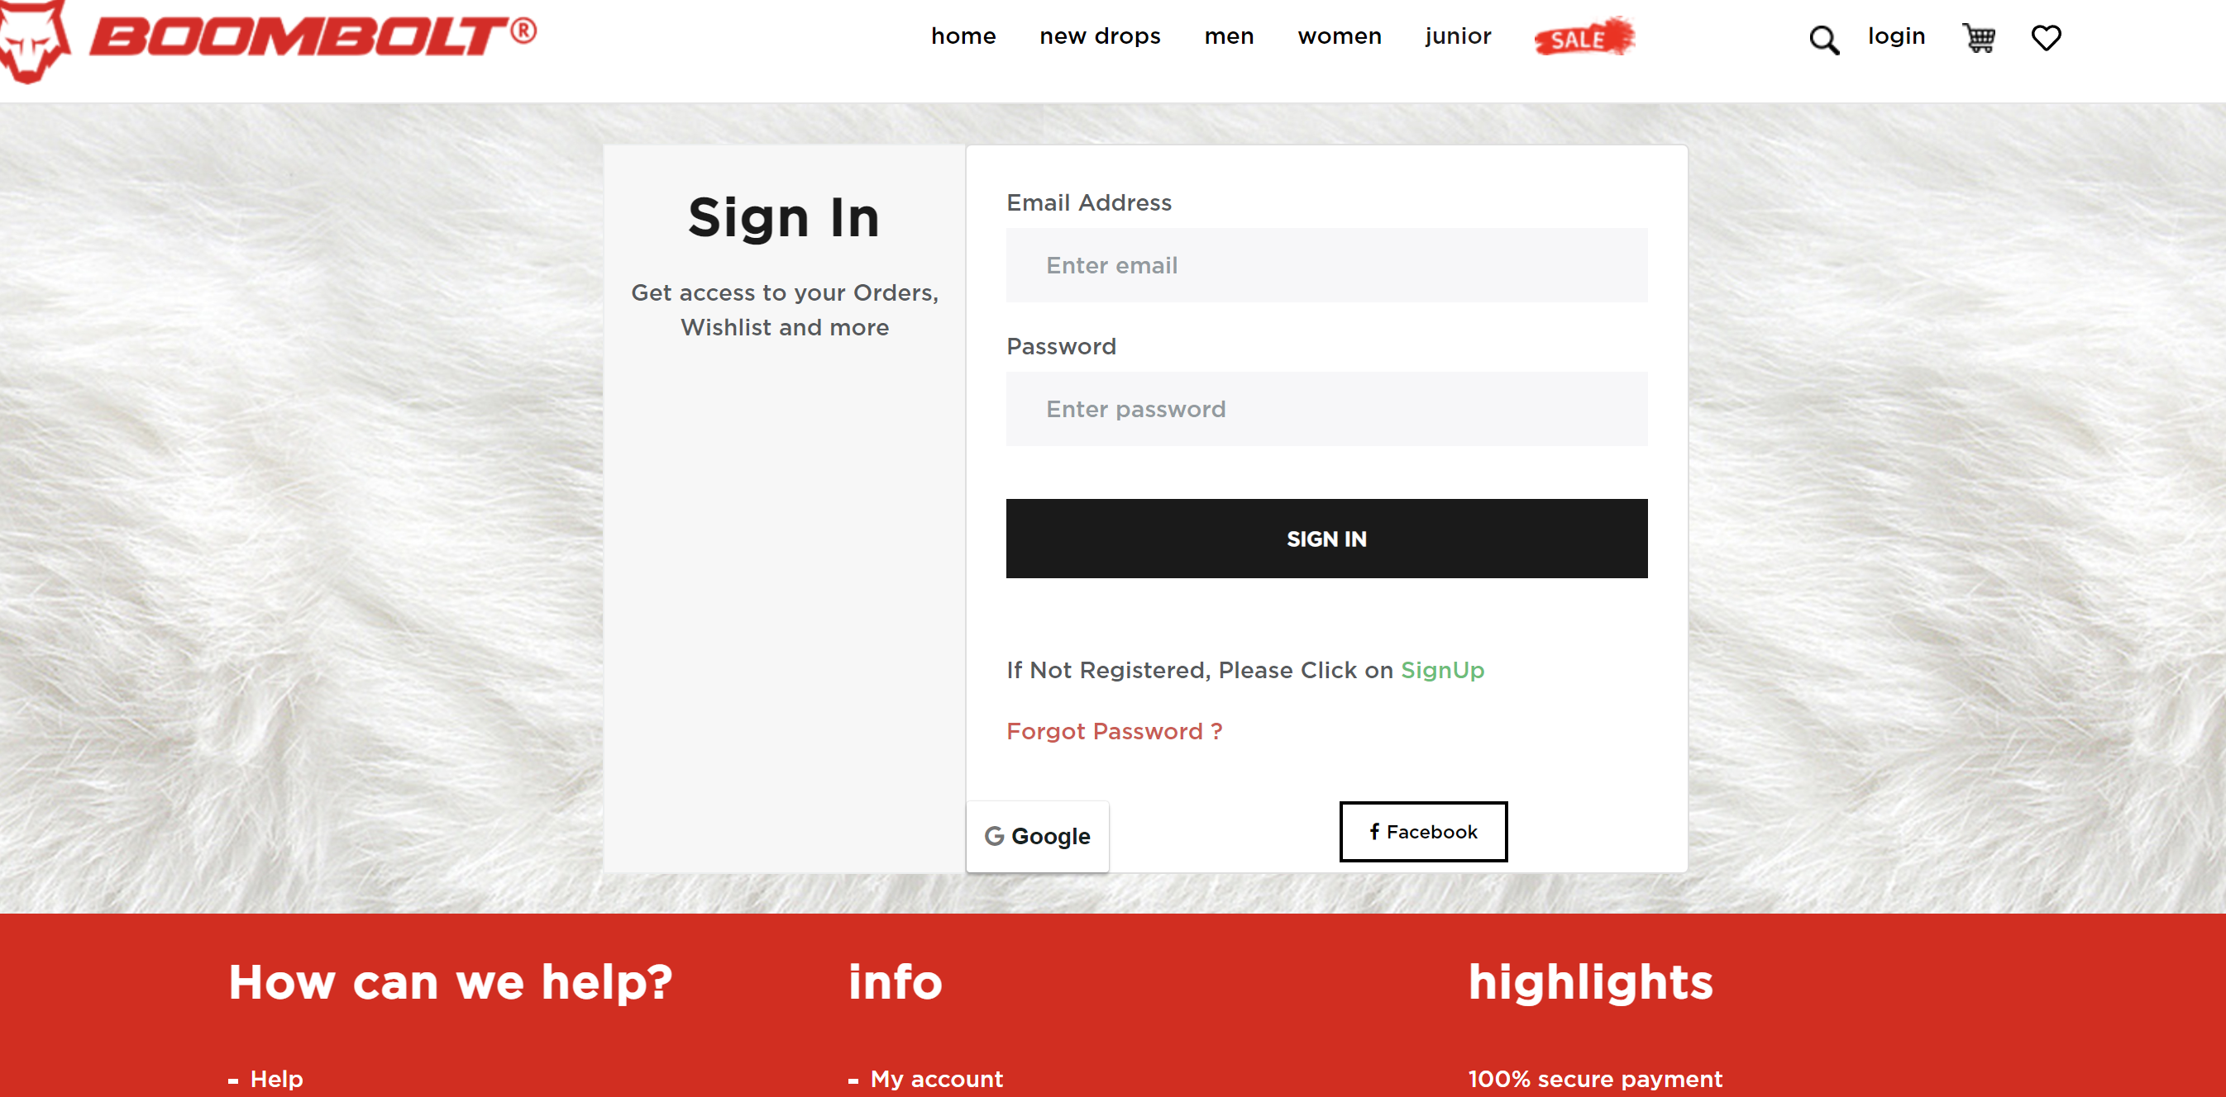
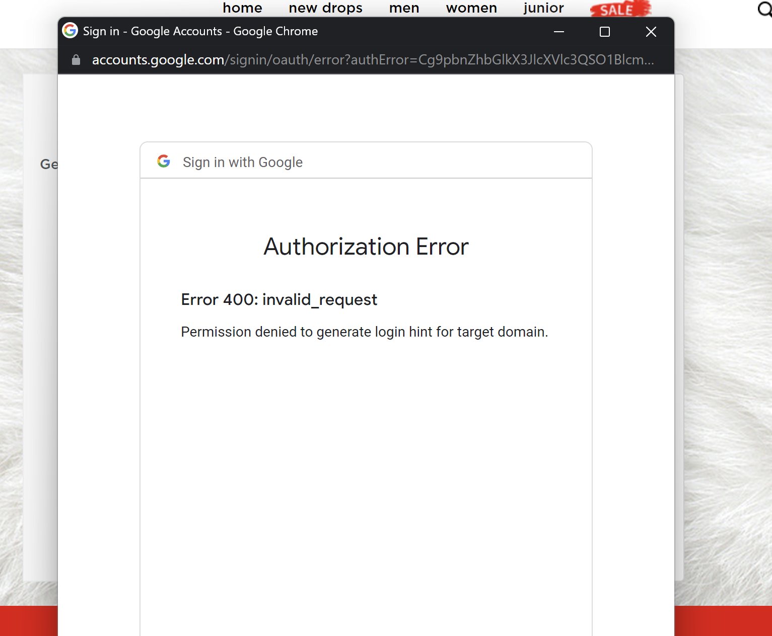
Fur Background to be removed.
No alignment for Google and Facebook boxes.
Should show actual logos in color
Google login showing error.

